Slide 1
Sho and .NET Bio

Slide 2
Information in this document is subject to change without notice. The example companies, organizations, products, people, and events depicted herein are fictitious. No association with any real company, organization, product, person or event is intended or should be inferred. Complying with all applicable copyright laws is the responsibility of the user.
Microsoft may have patents, patent applications, trademarked, copyrights, or other intellectual property rights covering subject matter in this document. Except as expressly provided in any license agreement from Microsoft, the furnishing of this document does not give you any license to these patents, trademarks, or other intellectual property.
© 2011 Microsoft Corporation. All rights reserved.
Microsoft, MS, Windows, MSDN, Visual Basic, Visual C++, Visual C#, and Visual Studio are either registered trademarks or trademarks of Microsoft Corporation in the U.S.A. and/or other countries.
Other product and company names herein may be the trademarks of their respective owners.
Microsoft Biology Initiative Training by Microsoft Corporation is licensed under a Creative Commons Attribution 3.0 Unported License. Based on a work at research.microsoft.com/bio.

Slide 3
Agenda
Introduction to Sho
Introduction to IronPython
Working with .NET
Using .NET Bio with Sho
Graphing and Statistics
Other

Slide 4
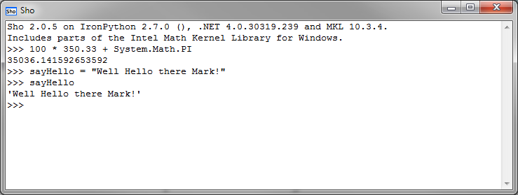
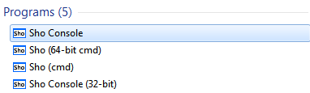
What is Sho?
Sho is an interactive data analysis tool
provides quick prototyping and on-the-fly analysis via scripting
built on top of Iron Python and .NET 4.0
includes command line and interactive console hosts

Slide 5
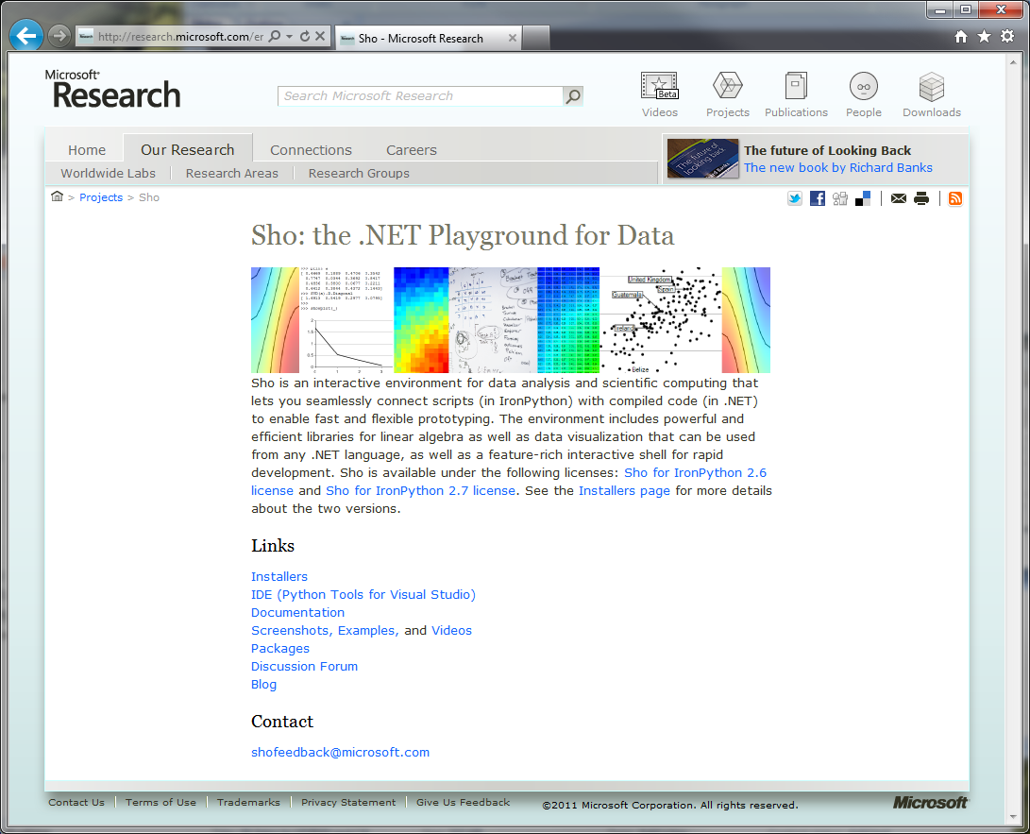
How do I get Sho?
Sho is available from Microsoft Research
http://research.microsoft.com/en-us/projects/sho/
for research and non-commercial purposes only

Slide 6
Installing Sho
Two versions of Sho available today
for IronPython 2.6
for IronPython 2.7
Sho for IronPython 2.6
includes binaries for IronPython 2.6 as part of install
standard Python libraries are not included (install separately)
supports HPC and Azure (also a separate package)
Sho for IronPython 2.7
requires you install IronPython first from codeplex
includes support for Visual Studio 2010 (separate install)
Pick the installation appropriate to you
http://research.microsoft.com/en-us/projects/sho/installers.aspx

Slide 7
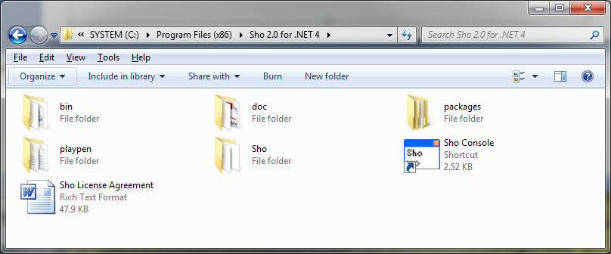

What do I get?
Sho installs core packages and several custom Python scripts
%Program Files%\Sho 2.0 for .NET 4
includes both command-line and REPL IDE
doc folder includes Book of Sho which is required reading

Slide 8
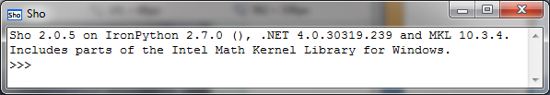
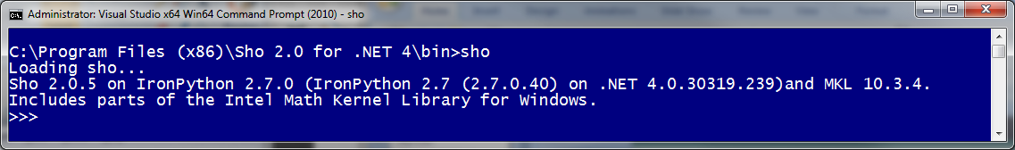
Running Sho
Easiest way to run Sho is through interactive console
added to Start Menu during installation
includes history, command completion, key bindings and more
Can also run from a command prompt
Sho.bat included in \bin folder runs console prompt

Slide 9
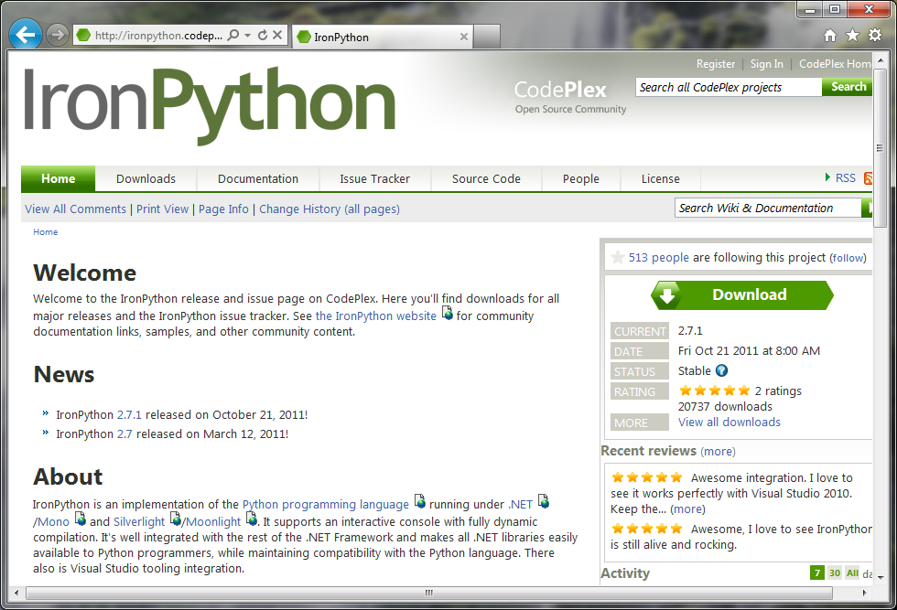
Introducing IronPython
IronPython is an implementation of Python on .NET
open source project at http://ironpython.codeplex.com/
currently based on Python 2.7

Slide 10
Let's start with Python
Python is a scripting language with object oriented features
created in 1990 by Guido van Rossum (BDFL)
runs on almost every operating system today (server or client)
free to use, licensed under OSI open-source license^{[1]}
Several features make it easy to learn and use
language is dynamically typed (but enforced at runtime)
memory is managed automatically
language style is oriented around simplicity and highly readable
But still has many powerful capabilities
dynamic expression evaluation
list comprehensions and generators
anonymous functions (lambda expressions)
Notes:
[1] CPython is a reference implementation owned by the Python Software Foundation (www.python.org) which is open-source and free.

Slide 11
Comments in Python
Comments allow the code to be documented
single line comments denoted by hash (#)
multi-line comments use triple-" (""")
Useful when defining classes, functions or sharable modules
# This is a comment in Python
a = 10 # This is also a comment
""" This begins a comment
which continues until we close the block """

Slide 12
Assigning values
Variables hold some state and are bound to a name
name follows sensible rules (start with a letter, etc.)
uses duck typing at runtime to evaluate methods
print built-in-function (BIF) displays strings on the screen
>>> i = 10
>>> d = 3.14
>>> s = "Hello"
>>> print i, d, s
10 3.14 Hello
>>> d = "Now I'm a string!"
>>> d
"Now I'm a string!"
variables can change value and type over time

Slide 13
Data Types
Python exposes commonly used data as built-in types
internally they are objects tracked and managed by Python
Can also create your own custom types or import new types
Sho adds a bunch of new types for example
Data Type | Example
Numbers | 10, 3.14, 2+2, 5*10, 2**10,
Strings | "Hi", 'Hello', str(500), "c:\\", "a" + "b", r'c:\demo'
Lists | [1,2,3] [1, [2,"three"],4] or list('123'), [1,2,3]+[4,5,6]
Dictionaries | { 1 : 'red', 2 : 'blue', 3 : 'green' }
Tuples | ( 1, "two", 3, "four" ) or () or (1,)
Sets | set('abc') or { 'a', 'b', 'c' } or set(['a', 'b', 'c'])
Booleans | True or False (note: case-sensitive!)

Slide 14
Statements
Programs are composed of statements and expressions
logic is driven through statements (if, while, for, etc.)
small = 200
large = 5
if small > large :
temp = small
small = large
large = temp
print small, large
compound statements
use colon ":"
nested blocks are
delimited using
indentation

Slide 15
Conditions and Operators
Assignments
Conditional tests combined with and / or operators
Ternary assignment
x = 10
if x == 10 or x > 20 or x <= 5 : …
if x > 5 and x < 10 and x != 6 : …
if not x == 10
maxNumber = y if x < y else x

Slide 16
If / Else Statements
If / Else logic allows branching based on true/false conditions
elif and else conditions are optional but else must be last
if
condition
:
processing logic
elif
condition
:
processing logic
else
condition
:
processing logic

Slide 17
If / Else example
job = "Shop Keeper"
if job == "Lumberjack":
print("I'm a lumberjack and I'm ok")
elif job == "Army Instructor":
print("Self Defense Against Fresh Fruit")
# allowable to place single statements on same line
elif job == "Knight": print("It's just a flesh wound!")
else:
print("That's a sleeping Norwegian Blue")

Slide 18
Counted Loops
Iterator loops are supported through the for keyword
for
identifier
in
list
:
list processing logic
(suite)
for value in [1,2,3] : print value
total = 0
for x in range(0,10) : # from 0 - 9
total = total + x
print total

Slide 19
Conditional Loops
Conditional loops are supported through the while keyword
while
condition
:
processing and state logic
x = 1
while x < 100 :
print x
x = x * 5

Slide 20
List Comprehension
Lists are central to Python – and have some special features
list comprehension allows easy generation and translation
traditional transformational loop
evenNumbers = list()
for val in range(100):
evenNumbers.Add(val*2)
using list comprehension:
evenNumbers = [val*2 for val in range(100)]
[
for
expression
statement
]
generates a new list

Slide 21
Indexing and Slicing
Lists provide element access with zero being the first element
Can also slice lists to access specific ranges
>>> l = [[1,2,3],[4,5,6],[7,8,9]] #
>>> l[0]
[1, 2, 3]
>>> l[1][2]
6
[
start
:
end
:
step
]
>>> l[1:2]
[[4, 5, 6]]
>>> l[2:][0][2:3]
[9]

Slide 22
Interesting index behavior
Negative indexes work from the end of the list
-1 is the last element, -2 is the second from last, etc.
>>> s = "This is a test"
>>> s[-1]
't'
# this works with slicing too
>>> s[::-1]
'tset a si sihT'

Slide 23
Defining reusable Functions
Functions allow linear programs to be broken into pieces
allows recursion and reuse
makes the program more readable
def
function_name
(
parameters
)
:
function logic
def fibonacci(value) :
if value == 0: return 0
elif value == 1: return 1
else : return fibonacci(value-1) + fibonacci(value-2)
fibonacci(10) # call it like any other built-in-function

Slide 24
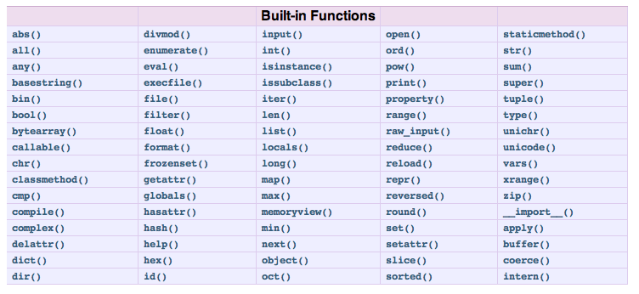
Built-in Functions
Python has several built-in functions (BIFs)
see http://docs.python.org/library/functions.html

Slide 25
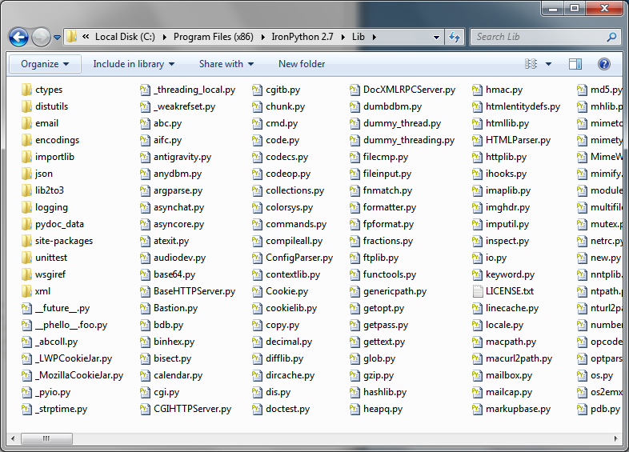
Python Standard Library
Python includes an extensive standard library
http://docs.python.org/library/
and there are lots of 3rd party libraries out there
Using the standard library requires importing modules
a module is a reusable block of code in a separate ".py" file
typically contained in a known folder
>>> import math
>>> math.sin(math.pi / 2)
1.0
>>>
Here we use the standard math module to do some calculations

Slide 26
Reducing the typing
The import function loads a module (.py)
you still need to fully declare the module + type to access it
The from function can be used to shorten the access
it brings the module's contents into the global namespace
You can also import all types from a module
>>> from datetime import date
>>> now = date.today() # no longer need datetime.date
>>> now
datetime.date(2011, 11, 21)
>>> from zlib import * # imports all types
>>> s = compress("Original String")
>>> decompress(s)
'Original String'

Slide 27
Getting help
The dir BIF provides a list of all callable methods
can also use the help() BIF for more detail on some things
>>> import math
>>> dir(math)
['__doc__', '__name__', '__package__', 'acos', 'acosh', 'asin', 'asinh', 'atan', 'atan2', 'atanh', 'ceil', 'copysign', 'cos', 'cosh', 'degrees', 'e', 'erf', 'erfc', 'exp', 'expm1', 'fabs', 'factorial', 'floor', 'fmod', 'frexp', 'fsum', 'gamma', 'hypot', 'isinf', 'isnan', 'ldexp', 'lgamma', 'log', 'log10', 'log1p', 'modf', 'pi', 'pow', 'radians', 'sin', 'sinh', 'sqrt', 'tan', 'tanh', 'trunc']
>>>
methods with underscores around them are internal methods for the object – typically these represent internal class information

Slide 28

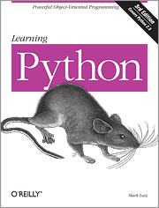
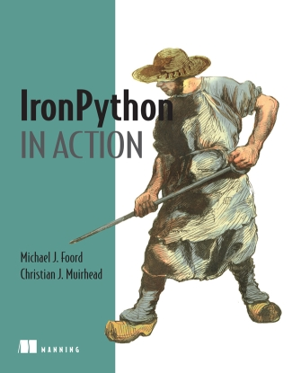
and so much more…
Python is a full-feature language with more to learn
http://docs.python.org/tutorial/ has great tutorials
Great books available too
Notes:
For example – it supports OO semantics such as classes, reusable modules, etc.

Slide 29
Back to IronPython
IronPython brings the goodness of Python to .NET
full implementation – all Python libraries are available to you
runs on the Dynamic Language Runtime (DLR) and .NET 4
provides seamless integration with .NET
Python
DLR
IronPython
Notes:
Interestingly enough, IronPython runs under Mono and Silverlight as well as the full desktop CLR.

Slide 30
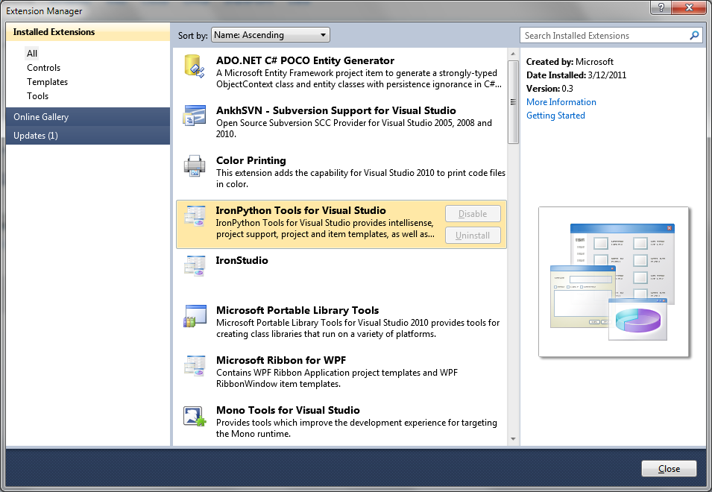
Using IronPython with Visual Studio
Optional tools can be added to Visual Studio 2010
adds support for IronPython projects and debugging
access through the Extensions Manager

Slide 31
Importing .NET types
IronPython supports adding references to .NET types
core assemblies are automatically added to the session^{[1]}
You can add other assembly references using the clr module
>>> import System # just import the CLR namespace here
>>> dt = System.DateTime.Now
>>> dt.ToString()
'11/21/2011 1:30:01 PM'
note: this is an example – you should really use the datetime module built into Python – in most cases you will find the standard library to be very complete
>>> clr.AddReference("PresentationFramework")
>>> clr.LoadAssemblyByPartialName("PresentationCore")
<Assembly PresentationCore, Version=4.0.0.0, Culture=neutral, PublicKeyToken=31bf3856ad364e35>
Notes:
[1] To see what's loaded, try this: System.AppDomain.GetAssemblies(System.AppDomain.CurrentDomain)

Slide 32
Using .NET Generics
IronPython adds a special bracket syntax to support generics
>>> from System.Collections.Generic import SortedList
>>> sList = SortedList[int,str]()
>>> sList.Add(10,'Hello')
>>> for s in sList: print s
[10, Hello]
the elements inside the brackets represent the generic types which supply the concrete definition of the type .. here it is an integer and a string type

Slide 33
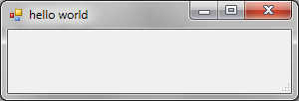
Custom Sho additions
Sho adds several features to IronPython
creating threads with ShoThread
easier loading of assemblies with ShoLoadAssembly
special array and matrix classes for calculations
graphing support
data grid
here we create a Windows Form – putting it onto it's own thread so it can process the message loop and remain interactive
>>> form = System.Windows.Forms.Form(Text="hello world")
>>> thread = ShoThread(form.ShowDialog)
>>> thread.Start()

Slide 34
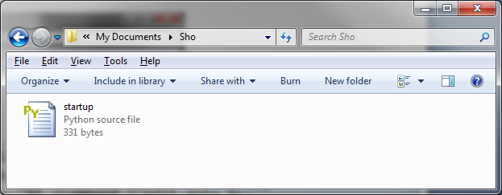
Customizing the environment
startup.py is run by Sho at startup
provides initial opportunity to customize values
located in Documents\Sho folder
# Sets Visual Studio as the default editor for Sho
sys.Sho.Editor = "devenv.exe"
sys.Sho.EditorArgs = "%f /command \"edit.goto %l\""
# Adds IronPython Libraries
sys.path.append(r"C:\Program Files (x86)\IronPython 2.7\Lib")
Notes:
Here we set the editor to Visual Studio (the default is notepad) and ensure the IronPython 2.7 std. libraries are in our path.

Slide 35
Array and Matrix classes
Sho includes several custom data analysis array classes
DoubleArray and SparseDoubleArray to hold double values
FloatArray and SparseFloatArray to hold floating point values
IntArray and SparseIntArray to hold integer values
BoolArray and SparseBoolArray to hold Boolean values
ComplexArray for complex numbers
ObjArray and SparseObjArray for general .NET objects
These collection types have special methods defined for
linear algebra (accelerated via the Intel MKL)

Slide 36
Creating arrays
The array classes support single or multi-dimensional creation
Can also create arrays from Python list or generator
>>> x = DoubleArray(10) # 1x10 array
>>> x = DoubleArray(10,1) # 10x1 array
>>> x = DoubleArray(10, 12) # 10x12 array
>>> x = DoubleArray(3, 4, 5) # 3x4x5 multidimensional array
>>> x = DoubleArray.From([1,2,3,4,5])
>>> x.Size
Array[int]((1, 5))
>>> x
[ 1.0000 2.0000 3.0000 4.0000 5.0000]
output looks like a normal Python list – it can be iterated just like one as well
Notes:
There are several specialized creator functions included too –
eye(cols,rows) creates identity matrices
ones creates matrixes filled with ones
zeros create matrixes filled with zeros
rand creates matrices filled with random numbers

Slide 37
Manipulating Arrays
Operators work as mathematical operations
slicing works too
>>> a = DoubleArray.From([[14,9,3],[2,11,15],[0,12,17],[5,2,3]])
>>> b = DoubleArray.From([[12,25],[9,10],[8,5]])
>>> a
[ 14.0000 9.0000 3.0000
2.0000 11.0000 15.0000
0.0000 12.0000 17.0000
5.0000 2.0000 3.0000]
>>> b
[ 12.0000 25.0000
9.0000 10.0000
8.0000 5.0000]
>>> a*b
[ 273.0000 455.0000
243.0000 235.0000
244.0000 205.0000
102.0000 160.0000]

Slide 38
Sparse Arrays
Sparse matrix arrays allow creation of large sparse matrices
substantial memory savings when large blocks are zero
>>> sa = SparseDoubleArray(100,100)
>>> sa[1,1] = 1.0
>>> sa[2,2] = 2.0
>>> sa[3,3] = 3.0
>>> sa
[ 0.0000 0.0000 0.0000 0.0000 0.0000 ...
0.0000 1.0000 0.0000 0.0000 0.0000 ...
0.0000 0.0000 2.0000 0.0000 0.0000 ... ]
>>> for val in sa.Elements: print val.Row, val.Col, val.Value
1 1 1.0
2 2 2.0
3 3 3.0
can iterate through assigned values using the Elements enumerator

Slide 39
Searching Arrays
Several aggregation methods available
Min, Max, Mean, Std, Var
Find method allows efficient searching
>>> A = rand(10,10)
>>> A.Min()
0.0011000232776161392
>>> A.Max()
0.99575244635145754
>>> for idx in Find(A > 0.5) : print idx.Row, idx.Col, A[idx]
0 0 0.940997867352
0 2 0.607370113771
...
here we locate all elements with values > 0.5 in the matrix

Slide 40
Linear Algebraic methods
You can obtain the transposition of a matrix through T
The matrices also have methods for common operations
MultiplyTranspose (A^{T}A or AA^{T})
MultiplyAccum (A + sB)
MultiplyInto (s¹B^{(t)}C^{(t)} + s²A) [where s^{x} are scalars]
>>> o1 = DoubleArray.From([[1,1],[2,2],[3,3]])
>>> o1.T
[ 1.0000 2.0000 3.0000
1.0000 2.0000 3.0000]
>>> o1.MultiplyTranspose(False) # A * A.T
[ 2.0000 4.0000 6.0000
4.0000 8.0000 12.0000
6.0000 12.0000 18.0000]

Slide 41
More algebraic goodness
Sho includes more complex linear algebra decomposition classes
LU
QR
Schur
Cholesky
SVD
Eigenvalue
A generic dense solver
See the Book of Sho for full details
>>> A = rand(10,10)
>>> s = SVD(A)
>>> A_hat = s.U * s.D * s.V.T
>>> norm(A - A_hat, 1)
4.0786818367166688e-14

Slide 42
Graphing and Stats
Sho includes a comprehensive set of graphing capabilities
Line/Scatter Plots via plot
Bar charts using bar
Contour plots with contour
Bimap images with imageview
Histograms via hist and histogram
Datagrid with dgv
All of them have various options to control style of graph
legends, colors, symbols, etc.
Generally each graph has both external and internal viewers
can plot data inline with your console session
can also put graphs side-by-side for comparison

Slide 43
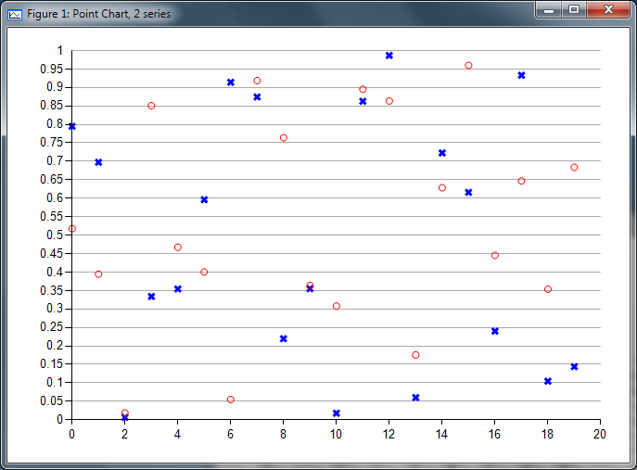
Plot graphs
plot function allows the generation of line and scatter plots
plot one or more data sets (must be equal length)
control line connection, symbol and color with string parameter
add legends with legend
connect: -,:,--,-.
colors: r,g,b,k,y,c,m,w
symbols: +,o,*,.,s,^,v
blue 'x' vs. red 'o'
>>> data1 = rand(20)
>>> data2 = rand(20)
>>> plot(data1,'xb',data2,'or')

Slide 44
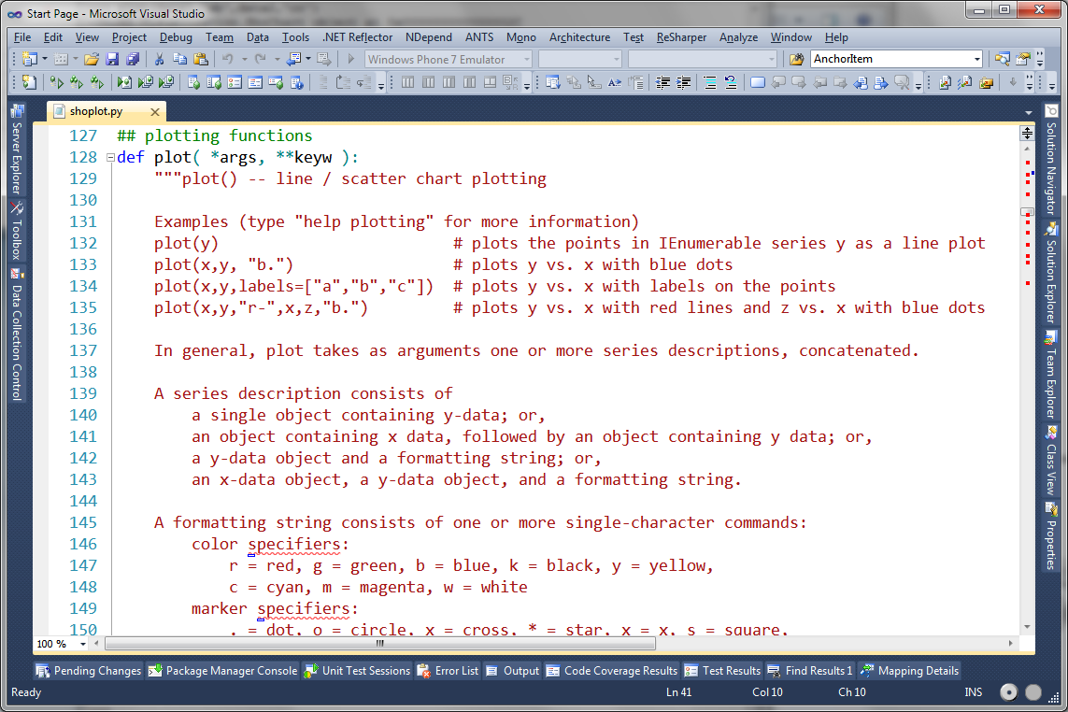
Advanced plots
Most of the plot aspects can be controlled with parameters
parameters evaluated by the function (comma-delimited)
helpful to look at the source code to see options
>>> edit(plot)
Opening file: shoplot.py at line 128
comments generally detail all the custom parameters you can tweak for that specific graph

Slide 45
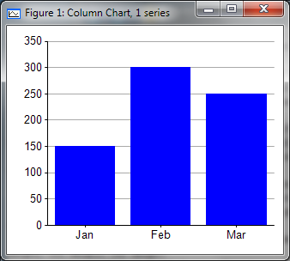
Bar Charts
bar function displays comparisons of data with bar chart
also has many control options such as color, legends, etc.
>>> months = ['Jan','Feb','Mar']
>>> numVis = [150,300, 250]
>>> bar(months, numVis, 'b')

Slide 46
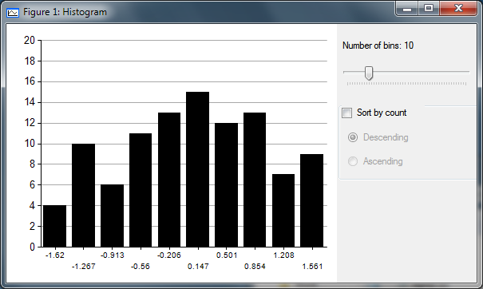
Histograms
Sho supports standard histogram analysis
can use Histogram class to get raw data and plot with bar
or interactive hist – allows you to change the bin dynamically
randn generates Gaussian-distributed
doubles which we then plot in a standard
^{histogram view}
>>> data = randn(100)
>>> Histogram(data)
[Histogram[(-1.6204,4);(-1.2668,10);(-0.9133,6);(-0.55976,11);(-0.20623,13);(0.1473,15);(0.50083,12);(0.85436,13);(1.2079,7);(1.5614,9)]]>
>>> hist(data)

Slide 47
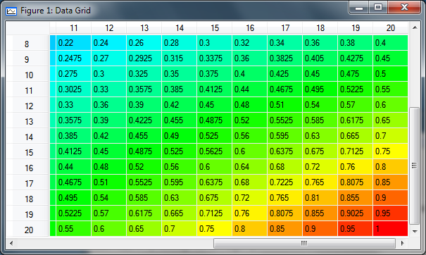
Data Grid
Sho has an editable data grid viewer for row/column style data
generally takes a 2D array of data for display (rows/columns)
lots of options here as well to tweak output
>>> heatMap = DoubleArray.From(drange(0,1,.05))
>>> dgv(heatMap.MultiplyTranspose(True),
color=True, colWidth=50)
F2 (or cell click) switches to "edit" mode, can disable by passing "edit=False"

Slide 48
Interacting with .NET Bio
Recall IronPython can load .NET assemblies
which is exactly what .NET Bio is ..
can use ShoLoadAssembly vs. clr.AddReference^{[1]}
>>> ShoLoadAssembly("c:/program files (x86)/.NET Bio/1.0/Tools/bin/Bio.dll")
<Assembly Bio, Version=1.0.4300.28638, Culture=neutral, PublicKeyToken=13335e9abfbf69d0>
>>> import Bio
>>> from Bio import *
>>> s = Sequence(Alphabets.DNA, "acgt")
>>> s
<Bio.Sequence object at 0x000000000000002B [acgt]>
>>>
Notes:
[1] The ShoLoadAssembly is essentially the same as: clr.AddReference(clr.LoadAssemblyFromFileWithPath(r"c:\Program Files (x86)\.NET Bio/1.0/tools/bin/bio.dll"))

Slide 49
Loading Sequences
Loading sequences into Sho is simply using the appropriate parsers or constructors
useful to then convert to Python lists
>>> parser = Bio.IO.FastA.FastAParser(r"data.fasta")
>>> allSequences = list(parser.Parse())
>>> sequence = allSequences[0]
>>> data = [chr(v) for v in sequence]
>>> data
['-', 'U', '-', '-', '-', '-', '-', 'G', 'G', '-', 'C', 'G', 'G', '-', 'C', 'C', 'G', 'U', 'A', '-', 'G', 'C', '-', 'G', 'C', '-', 'G', 'G', 'U', 'G', '-', '-', 'G', 'U', '-', 'C', 'C', '-', 'C', 'A', 'C', '-', 'C', 'U', 'G', 'A', '-', '-', 'C', 'C', 'C', 'C', 'G', 'C', 'A', '-', '-', '-', '-', '-', '-', '-', '-', '-', 'U', '-', '-', '-', '-']
>>>

Slide 50
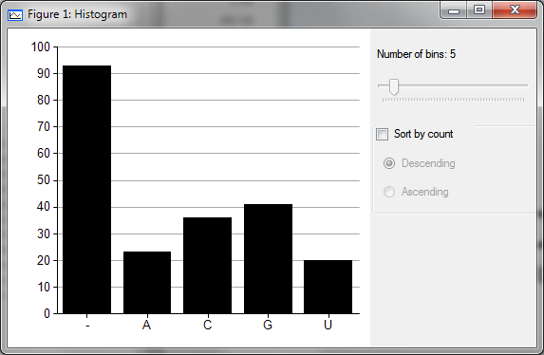
Graphing data
Can then use Sho graphing to present and manipulate data
>>> hist(sequence)

Slide 51
More information
Sho is capable of far more than what has been shown
you can embed it into a .NET application
even extend it with other .NET features
For more information go to
Book of Sho (included with Sho install) [required reading!]
http://blogs.msdn.com/b/the_blog_of_sho/
http://social.msdn.microsoft.com/Forums/br/theforumofsho/threads

Slide 52
Summary
Sho is a very powerful analysis tool
utilizes IronPython for interactive scripting
capable of loading and manipulating data easily
Sho adds great matrix and linear algebra capabilities
plus you get access to the entire Python standard library!
Mix in .NET Bio and you get a great scripting tool
quick analysis without significant programming required
load, manipulate and then save sequences back out
use graphs to analyze ratios, alignments, etc.

Slide 53
Disclaimer: This document is provided "as-is". Information and views expressed in this document, including URL and other Internet Web site references, may change without notice. You bear the risk of using it.
This document does not provide you with any legal rights to any intellectual property in any Microsoft product. You may copy and use this document for your internal, reference purposes.
© 2011 Microsoft Corporation. All rights reserved.
Microsoft, Visual Studio, and Windows are trademarks of the Microsoft group of companies. All other trademarks are property of their respective owners.

